Slide 1

BeSafe
Check your email for a safe use

Slide 2

The idea/1
BeSafe represents a distributed application to analyze suspicious email, in particular using machine learning based algorithms and other API to classify them in malicious or not

Slide 3
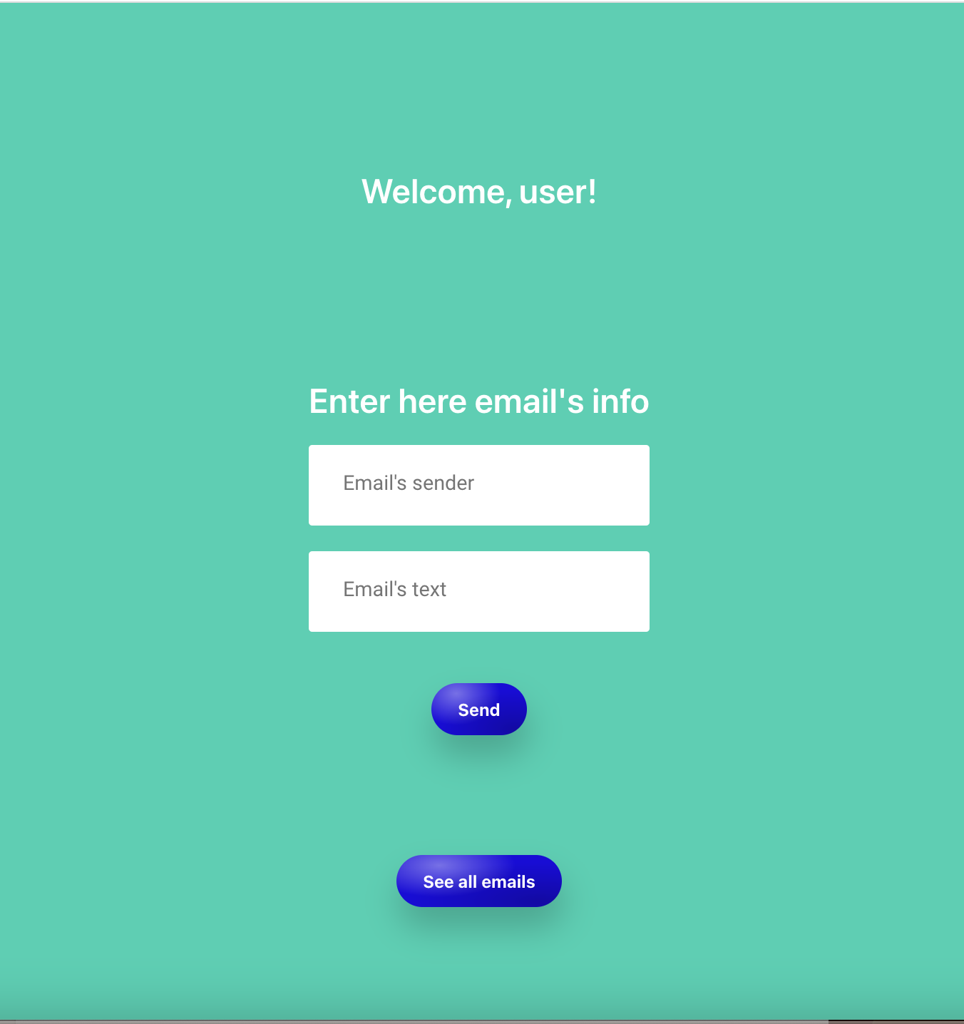
The idea/2
In this form user can insert email’s info in order to obtain its danger score

Slide 4
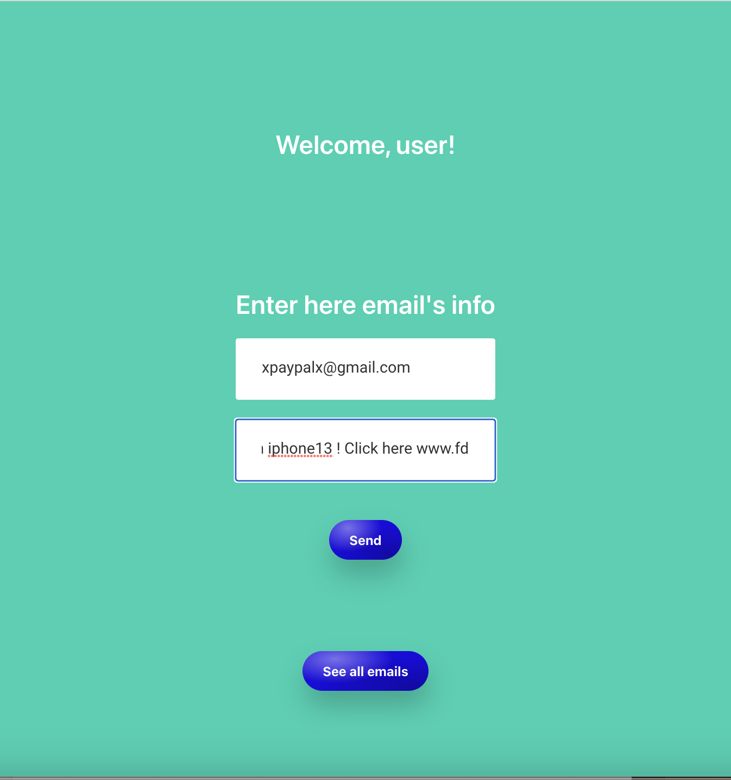
The idea/2

Slide 5
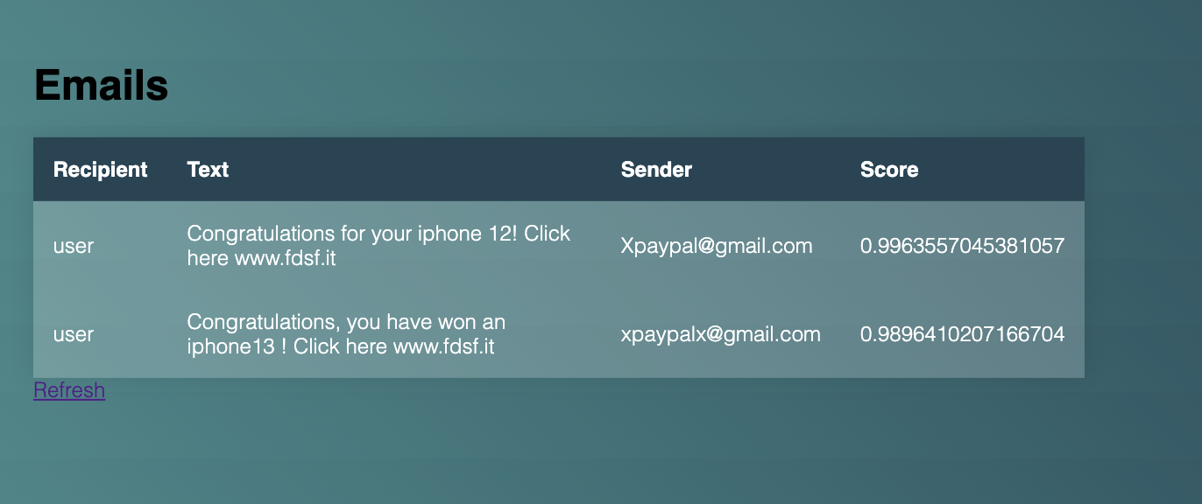
Idea/3
Here the user can understand the dangerousness of the emails arrived to him

Slide 6
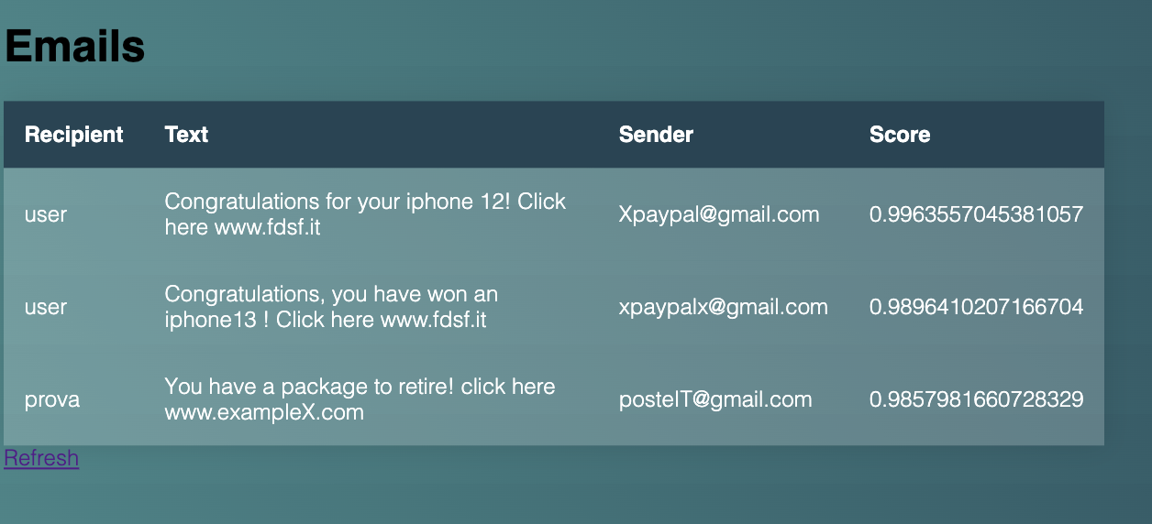
Idea/4
Here the admin can visualize all emails sent to the application

Slide 7
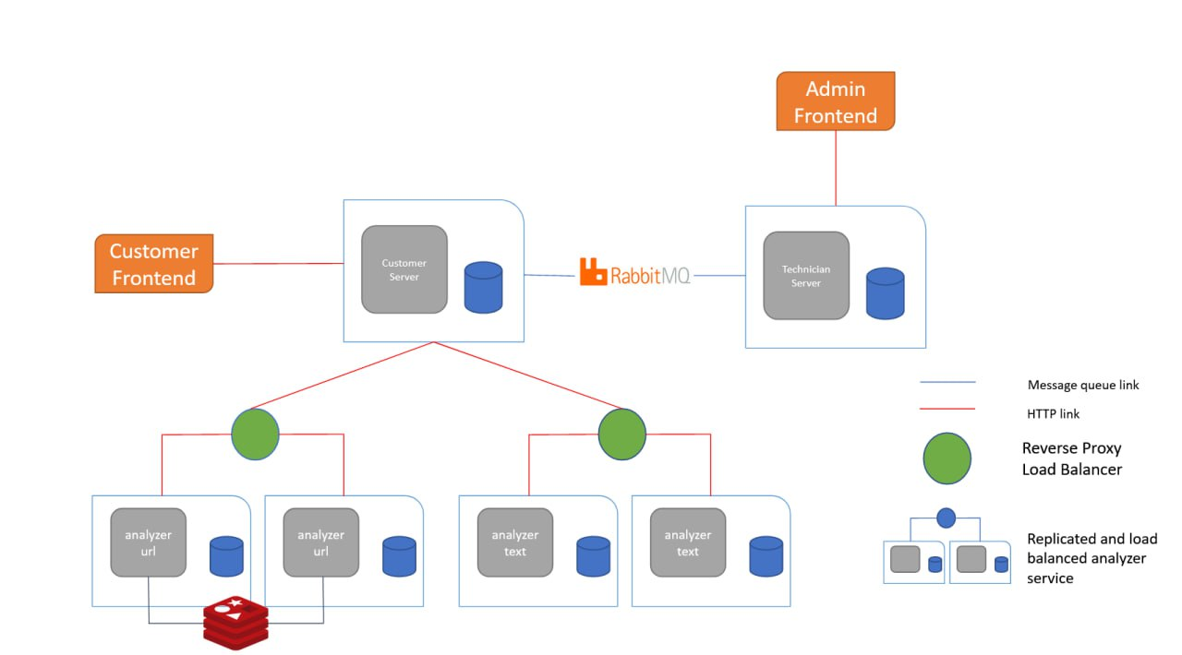
Architecture

Slide 8
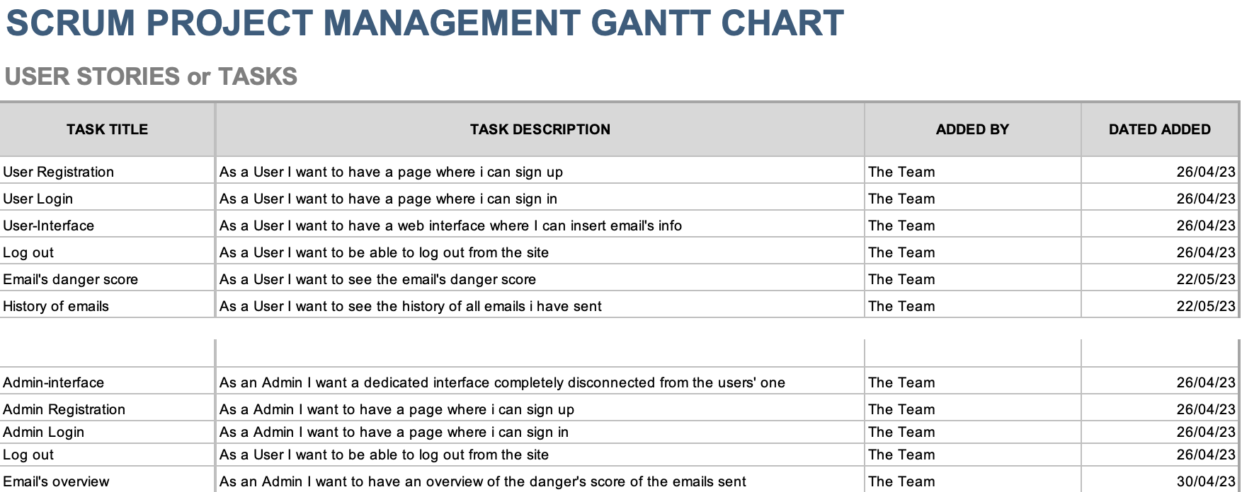
User Stories

Slide 9
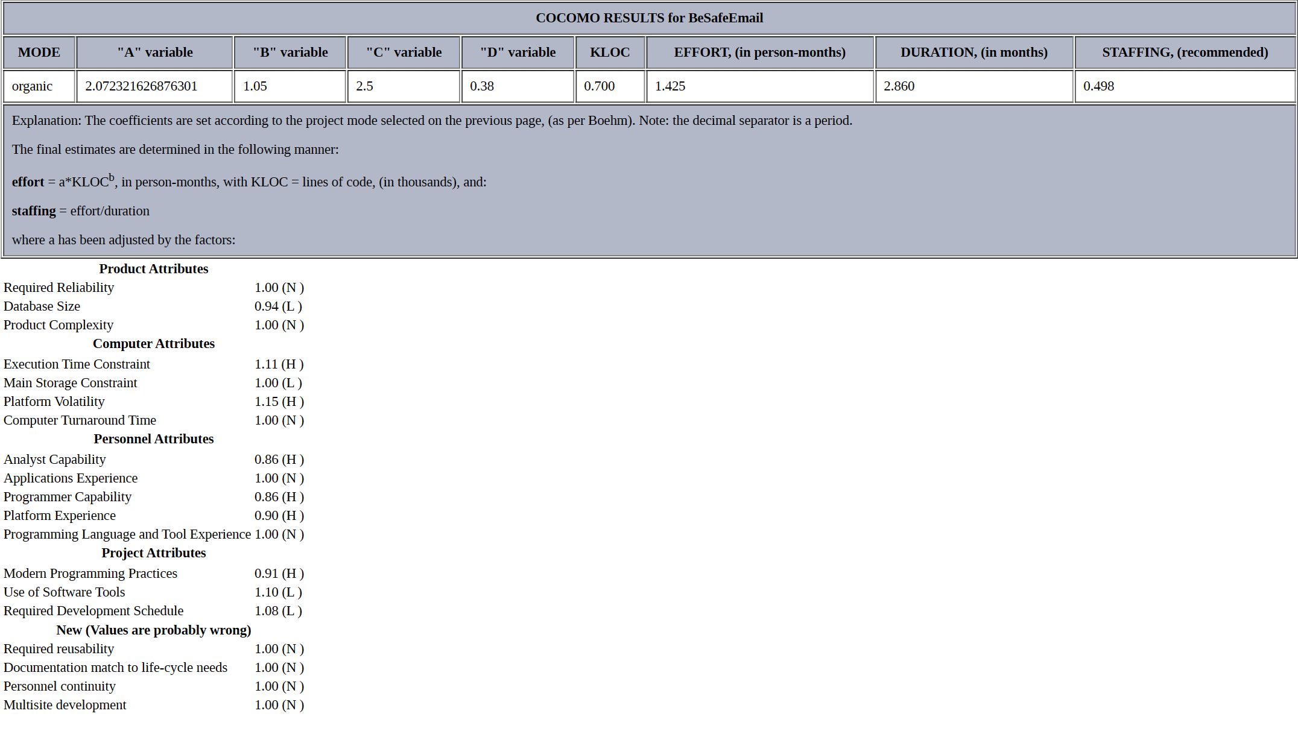
COCOMO

Slide 10
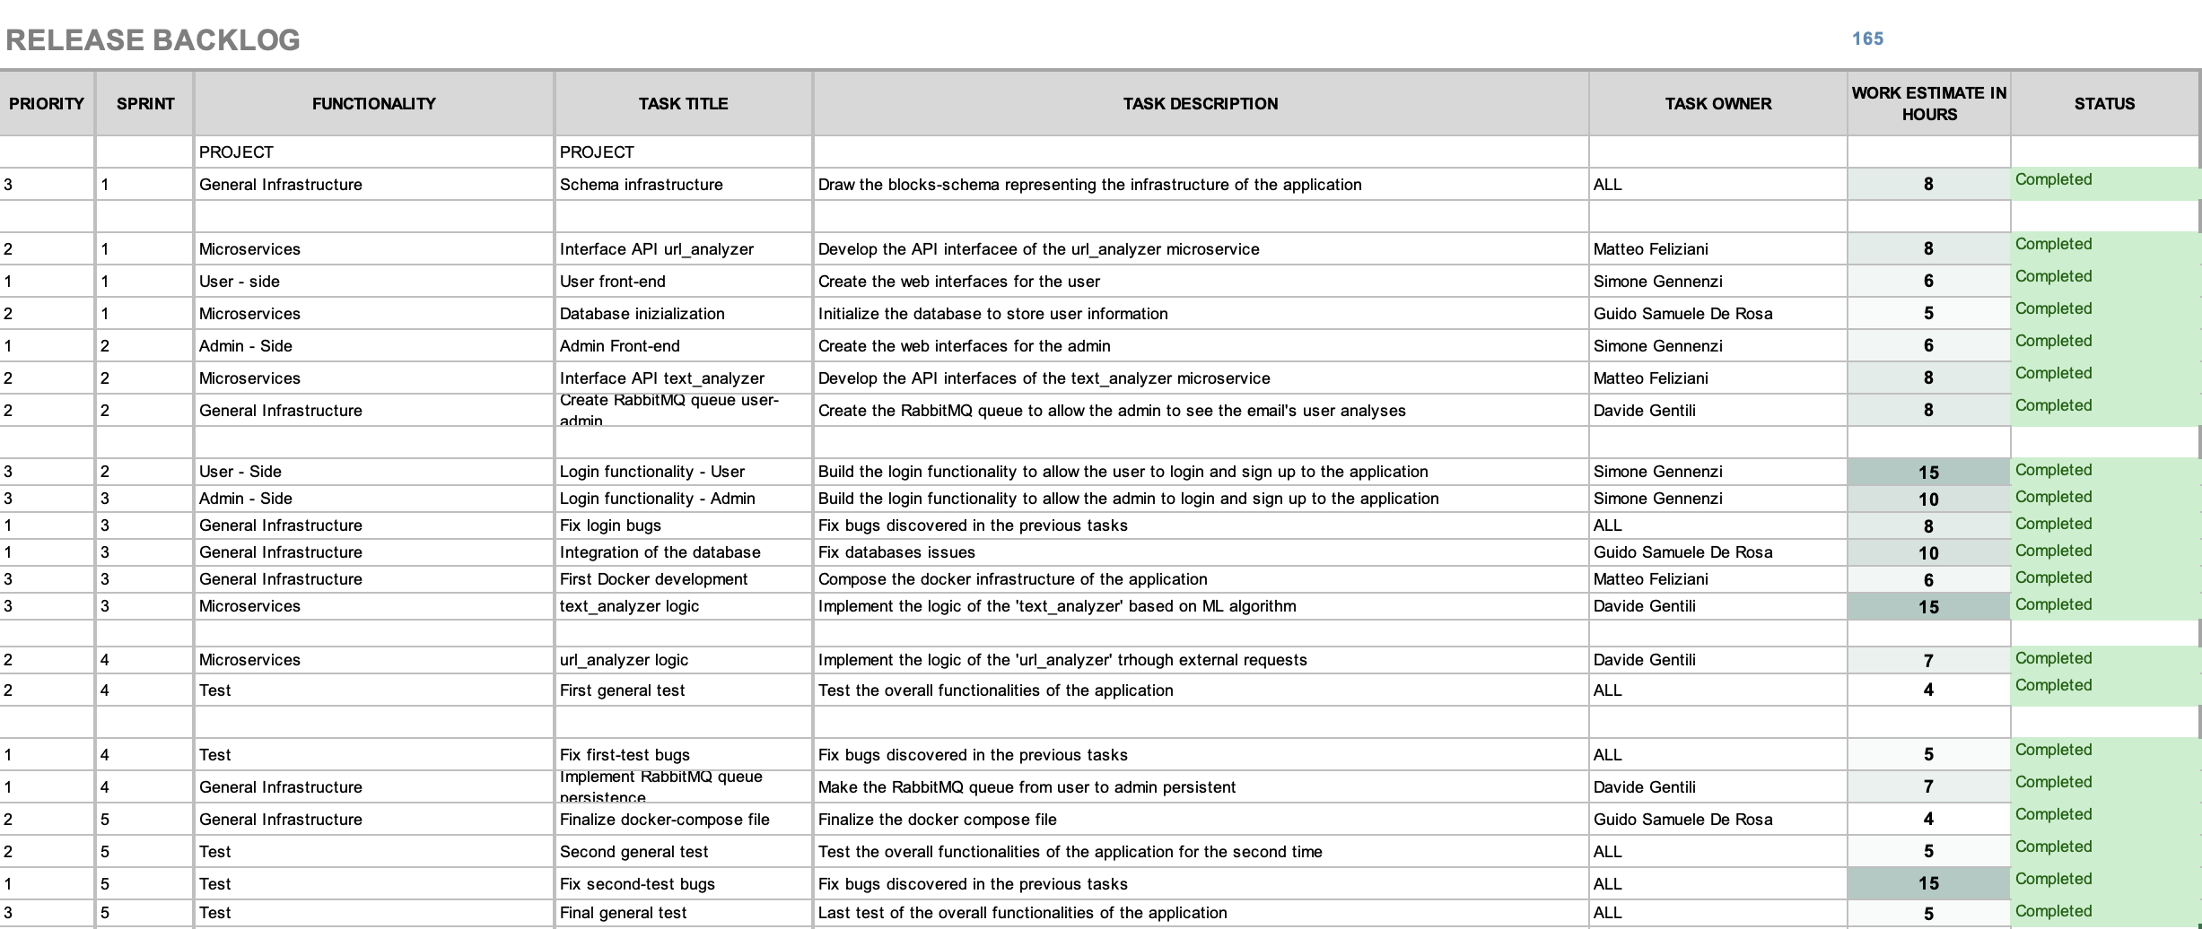
SCRUM

Slide 11
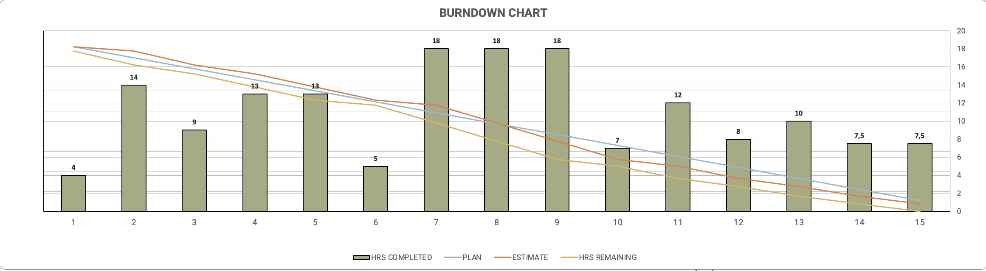
SCRUM

Slide 12
DEMO

